Slide 1
ED2 Spring 2025
Team and Project Introductions
Edit your team slide ONE slide per team. Max 5 mins per team. Slides will switch automatically after 5 mins.
Plan to cover:
Problem
Solution – your vision of what the end-product would look like
Key challenges and individual roles

Slide 2
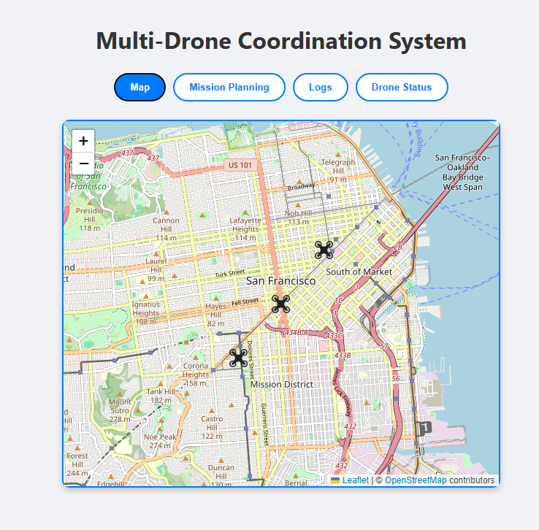
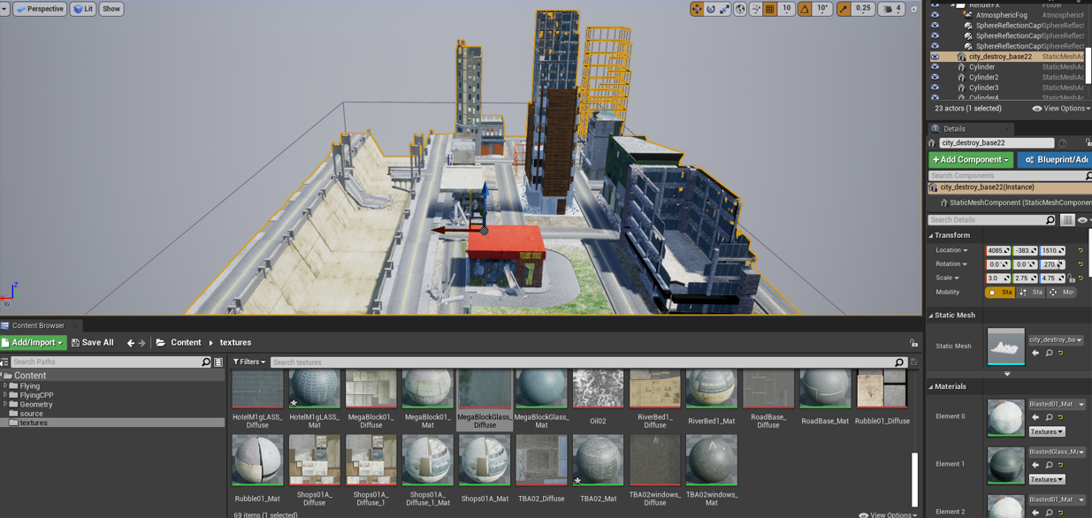
Multiple Drones Coordination
# 32
TEAM: Matthew Paternoster, Brenden Martins, Matthew Wyatt, Tarek Kayali, Tutku Gizem Guder
Problem​:
In disasters, humanity often struggles with the limits of what can be controlled, working to organize efforts amid chaos and unpredictable events. Natural and man-made disasters are not only devasting but can also leave lasting challenges for first responders. These include finding victims, organizing rescues, and keeping an eye on dangerous areas. All while under tight time constraints. Disasters such as earthquakes, floods, hurricanes, and building collapses put many lives at risks. Traditional response methods, which often rely on limited manpower and equipment, can lead to delays, inefficiencies, and greater risks for those involved in rescue efforts.
Solution:
Design a system that minimizes human risk by deploying drones in disaster ridden areas to assist with localized search and rescue efforts and making it capable of adapting to disasters of varying magnitudes, from localized incidents to widespread crises, through AirSim.
Key accomplishments so far:
Created a simulated 3D environment to be able to build set paths for the drones to follow.
Set up a MySQL database and API using ExpressJS.
Developed a mock UI using React.
The Target Detection Subsystem is in the early stages of development, with a simulation environment created and ongoing integration of sensors, machine learning models, and hardware to enable real-time target identification and communication among subsystems.

